Slide 1
Fundamentals of Ecology
Week 6, Ecology Lecture 2
Cara Brook
February 9, 2023

Slide 2
Let’s recap a bit!
Ecology, generally
Ecology is the study of organisms and their interactions with each other and the environment
We use models to formalize hypotheses about these interactions and test those hypotheses against data
We can ask questions at many ecological scales: individual, population, metapopulation, community, ecosystem
Population growth, specifically
We can model population growth as geometric in discrete time or exponential in continuous time
Logistic growth models describe density-dependent growth rates that limit population growth at some specified carrying capacity
Logistic growth models imply a stable equilibrium where the population size (N) is equal to the carrying capacity (K)
Fisheries have used this model to attempt to define a maximum sustainable harvest rate (MSY) to guide policy, but it has performed poorly because the models are not realistic
One shortcoming of the simple logistic growth model is a failure to include both environmental and demographic stochasticity

Slide 3
Let’s recap a bit!
Ecology, generally
Ecology is the study of organisms and their interactions with each other and the environment
We use models to formalize hypotheses about these interactions and test those hypotheses against data
We can ask questions at many ecological scales: individual, population, metapopulation, community, ecosystem
Population growth, specifically
We can model population growth as geometric in discrete time or exponential in continuous time
Logistic growth models describe density-dependent growth rates that limit population growth at some specified carrying capacity
Logistic growth models imply a stable equilibrium where the population size (N) is equal to the carrying capacity (K)
Despite the dire predictions of Malthus in the late 1700s, most human populations do not appear to yet be approaching carrying capacity

Slide 4
Let’s recap a bit!
Ecology, generally
Ecology is the study of organisms and their interactions with each other and the environment
We use models (especially population models) to formalize hypotheses about these interactions and test those hypotheses against data
We can ask questions at many ecological scales: individual, population, metapopulation, community, ecosystem
Population growth, specifically
We can model population growth as geometric in discrete time or exponential in continuous time
Logistic growth models describe density-dependent growth rates that limit population growth at some specified carrying capacity
Logistic growth models imply a stable equilibrium where the population size (N) is equal to the carrying capacity (K)
Despite the dire predictions of Malthus in the late 1700s, most human populations do not appear to yet be approaching carrying capacity

Slide 5
Let’s recap a bit!
Ecology, generally
Ecology is the study of organisms and their interactions with each other and the environment
We use models (especially population models) to formalize hypotheses about these interactions and test those hypotheses against data
We can ask questions at many ecological scales: individual, population, metapopulation, community, ecosystem
Population growth, specifically
We can model population growth as geometric in discrete time or exponential in continuous time
Logistic growth models describe density-dependent growth rates that limit population growth at some specified carrying capacity
Logistic growth models imply a stable equilibrium where the population size (N) is equal to the carrying capacity (K)
Despite the dire predictions of Malthus in the late 1700s, most human populations do not appear to yet be approaching carrying capacity

Slide 6
Let’s recap a bit!
Ecology, generally
Ecology is the study of organisms and their interactions with each other and the environment
We use models (especially population models) to formalize hypotheses about these interactions and test those hypotheses against data
We can ask questions at many ecological scales: individual, population, metapopulation, community, ecosystem
Population growth, specifically
We can model population growth as geometric in discrete time or exponential in continuous time
Logistic growth models describe density-dependent growth rates that limit population growth at some specified carrying capacity
Logistic growth models imply a stable equilibrium where the population size (N) is equal to the carrying capacity (K)
Despite the dire predictions of Malthus in the late 1700s, most human populations do not appear to yet be approaching carrying capacity

Slide 7
Let’s recap a bit!
Ecology, generally
Ecology is the study of organisms and their interactions with each other and the environment
We use models (especially population models) to formalize hypotheses about these interactions and test those hypotheses against data
We can ask questions at many ecological scales: individual, population, metapopulation, community, ecosystem
Population growth, specifically
We can model population growth as geometric in discrete time or exponential in continuous time
Logistic growth models describe density-dependent growth rates that limit population growth as abundance approaches some specified carrying capacity
Logistic growth models imply a stable equilibrium where the population size (N) is equal to the carrying capacity (K)
Despite the dire predictions of Malthus in the late 1700s, most human populations do not appear to yet be approaching carrying capacity

Slide 8
Let’s recap a bit!
Ecology, generally
Ecology is the study of organisms and their interactions with each other and the environment
We use models (especially population models) to formalize hypotheses about these interactions and test those hypotheses against data
We can ask questions at many ecological scales: individual, population, metapopulation, community, ecosystem
Population growth, specifically
We can model population growth as geometric in discrete time or exponential in continuous time
Logistic growth models describe density-dependent growth rates that limit population growth as abundance approaches some specified carrying capacity
Logistic growth models imply a stable equilibrium where the population size (N) is equal to the carrying capacity (K)
Despite the dire predictions of Malthus in the late 1700s, most human populations do not appear to yet be approaching carrying capacity

Slide 9
Let’s recap a bit!
Ecology, generally
Ecology is the study of organisms and their interactions with each other and the environment
We use models (especially population models) to formalize hypotheses about these interactions and test those hypotheses against data
We can ask questions at many ecological scales: individual, population, metapopulation, community, ecosystem
Population growth, specifically
We can model population growth as geometric in discrete time or exponential in continuous time
Logistic growth models describe density-dependent growth rates that limit population growth as abundance approaches some specified carrying capacity
Logistic growth models imply a stable equilibrium where the population size (N) is equal to the carrying capacity (K)
Despite the dire predictions of Malthus in the late 1700s, most human populations do not appear to yet be approaching carrying capacity

Slide 10
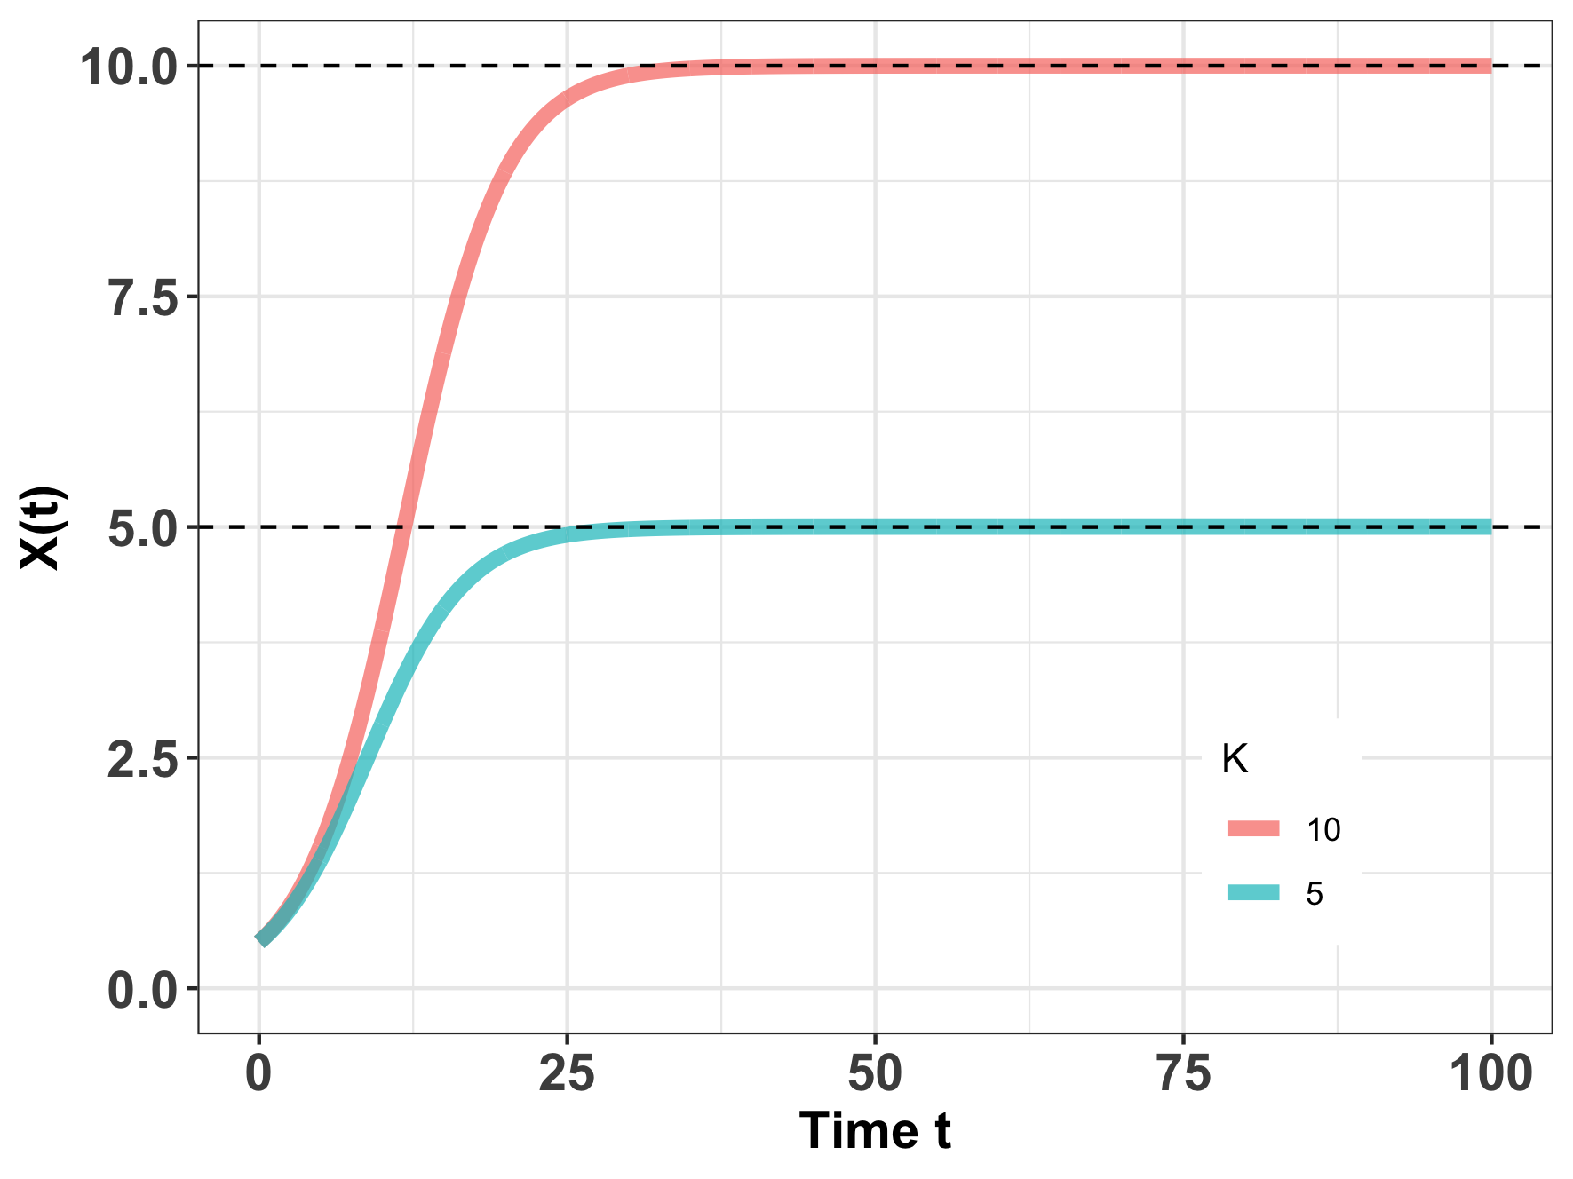
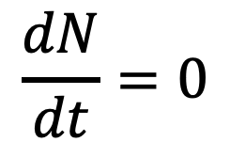
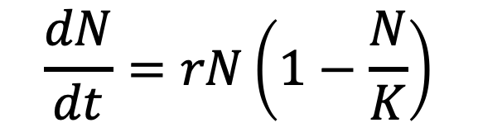
Logistic growth and equilibrium
$$\frac{dN}{dt}=rN\left(1−\frac{N}{K}\right)$$
$$\frac{dN}{dt}=0$$
When population size is not changing, the population is said to be at equilibrium.
Mathematically, the carrying capacity (K) can be shown to be a stable equilibrium, meaning that if the system is perturbed, it will return to this point.
Notes:
Logistic growth suggests that there are density-dependent growth rates and that carrying capacity is a stable equilibrium in the dynamical system.
When an This means that

Slide 11
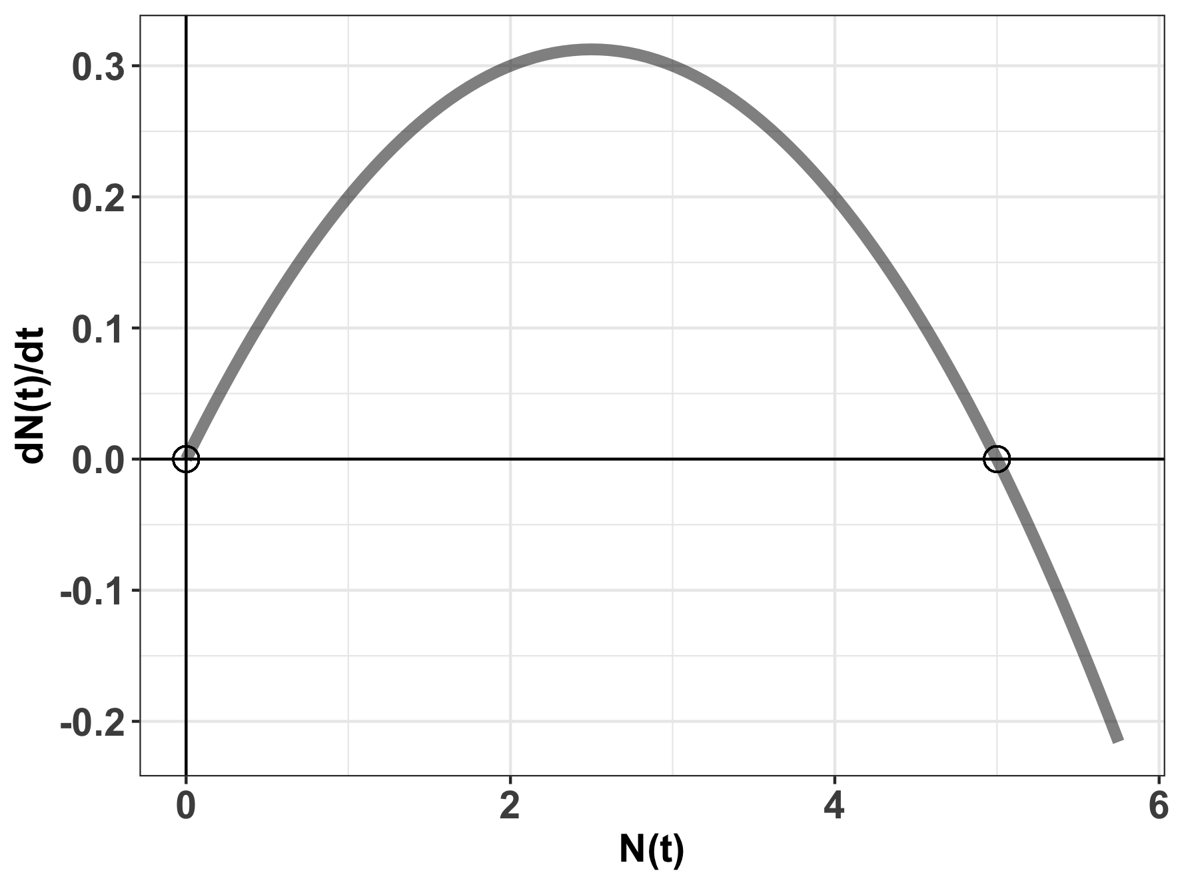

Logistic growth and equilibrium
$$\frac{dN}{dt}=rN\left(1−\frac{N}{K}\right)$$
$$\frac{dN}{dt}=0$$
$$K=5$$
When population size is not changing, the population is said to be at equilibrium.
Mathematically, the carrying capacity (K) can be shown to be a stable equilibrium, meaning that if the system is perturbed, growth will accelerate or decelerate to return the population to K.
Notes:
N= K is a stable equilibrium. Small negative perturbations to the system will result in r > 0 which will grow to N=K. Small negative perturbations to the system will result in r <0 and sink to N=K
N= 0 is an unstable equilibrium. Small perturbations to the system around N=0 will result in r > 0 which will grow to N = K.

Slide 12
Logistic growth and harvesting
Humans have attempted to leverage density-dependent growth rates for sustainable harvesting, which refers to the offtake of individuals within a population’s capacity for replenishment. Frequently, this refers to the harvesting of animals for human consumption.
Notes:
Now that we understand density-dependent growth, we’ll explore how humans have attempted to leverage this stability

Slide 13
Logistic growth and harvesting
Humans have attempted to leverage density-dependent growth rates for sustainable harvesting, which refers to the offtake of individuals within a population’s capacity for replenishment. Frequently, this refers to the harvesting of animals for human consumption.
The science of sustainable harvest is used extensively in fisheries management.
Notes:
Now that we understand density-dependent growth, we’ll explore how humans have attempted to leverage this stability

Slide 14
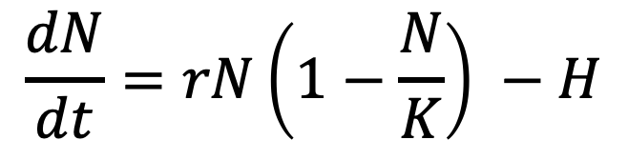
Logistic growth and harvesting
Humans have attempted to leverage density-dependent growth rates for sustainable harvesting, which refers to the offtake of individuals within a population’s capacity for replenishment. Frequently, this refers to the harvesting of animals for human consumption.
The science of sustainable harvest is used extensively in fisheries management.
population size
change in population size with time
$$\frac{dN}{dt}=rN\left(1−\frac{N}{K}\right) −H$$
harvesting rate
carrying capacity
intrinsic growth rate
density-dependence
Notes:
Now that we understand density-dependent growth, we’ll explore how humans have attempted to leverage this stability

Slide 15
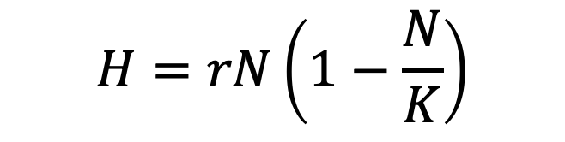
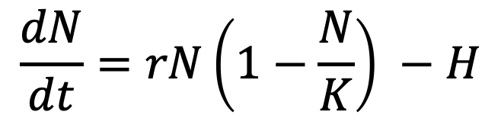
Logistic growth and harvesting
$$\frac{dN}{dt}=rN\left(1−\frac{N}{K}\right) −H$$
For a harvested population, theoretically, the population size is at equilibrium if the harvest rate equals the growth rate.
$$H=rN\left(1−\frac{N}{K}\right)$$

Slide 16
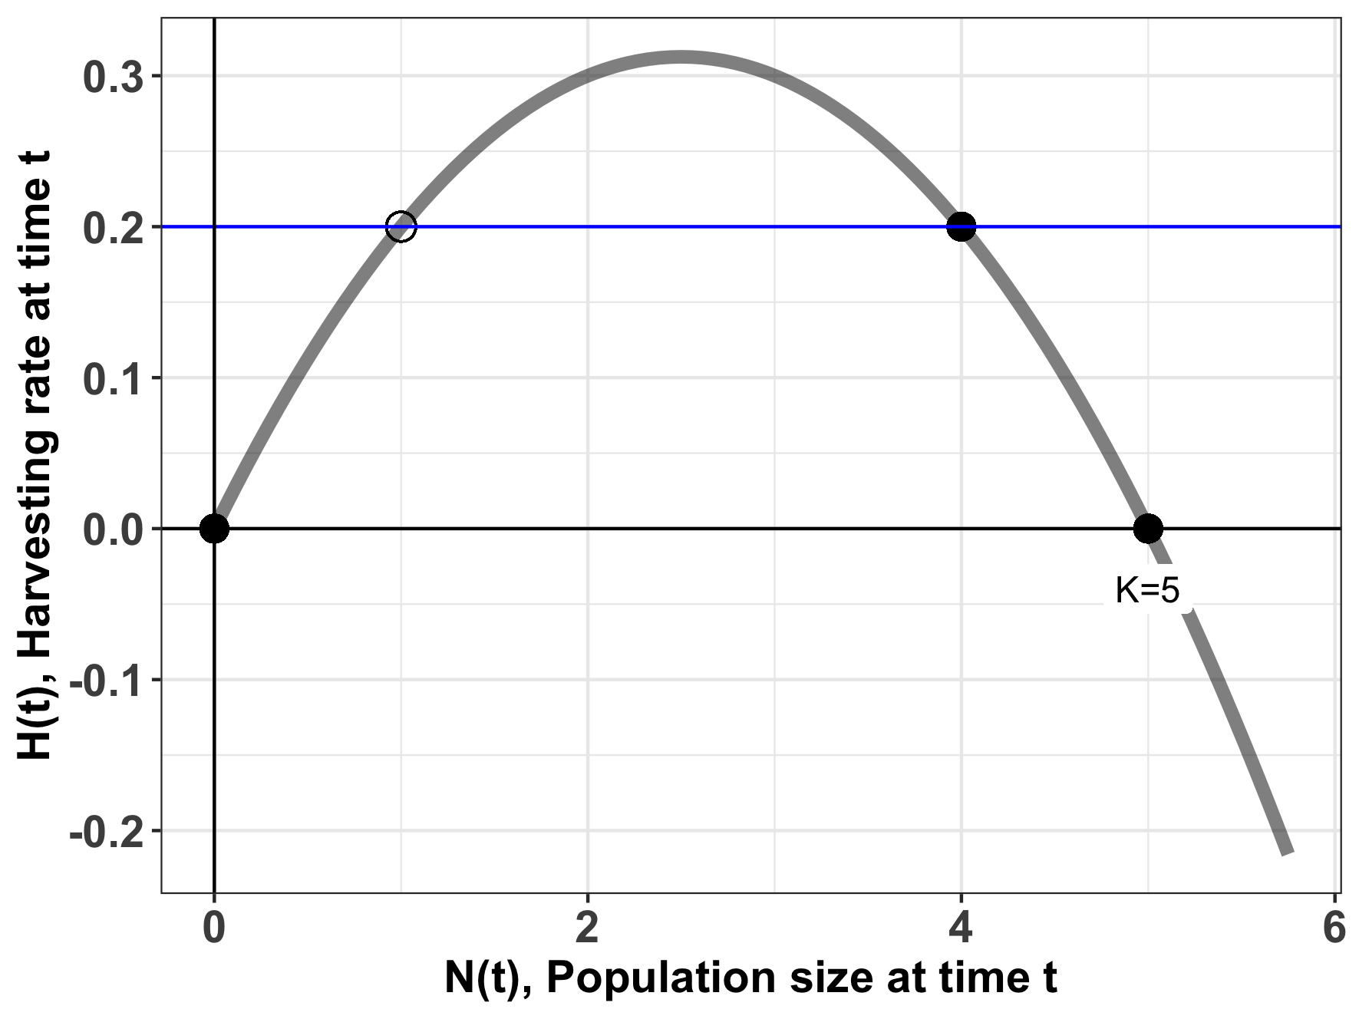
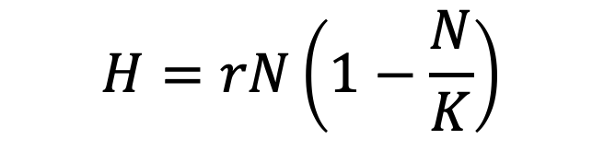
The stability of harvesting depends on population size.
$$H=rN\left(1−\frac{N}{K}\right)$$
harvesting rate
carrying capacity

Slide 17
The stability of harvesting depends on population size.
$$H=rN\left(1−\frac{N}{K}\right)$$
stable equilibrium
For a population of N=4, a harvest rate of 0.2 (animals/timestep) results in a stable equilibrium (sustainable harvest).
Notes:
N=4 is a stable equilibrium. Small negative perturbations to the system will result in r > 0 which will grow to N=4. Small negative perturbations to the system will result in r <0 and sink to N=4.
You can test this just by filling in values. This curve was built assuming r = 0.25 and K= 5. Try it testing N=2 (dN/dt eqn is positive) or N=6 (dN/dt eqn is negative)

Slide 18
The stability of harvesting depends on population size.
$$H=rN\left(1−\frac{N}{K}\right)$$
stable equilibrium
For a population of N=4, a harvest rate of 0.2 (animals/timestep) results in a stable equilibrium (sustainable harvest).
Increases or decreases in population size will be compensated to return the system to N=4.
Notes:
You can test this just by filling in values. This curve was built assuming r = 0.25 and K= 5. Try it testing N=2 (dN/dt eqn is positive) or N=6 (dN/dt eqn is negative)

Slide 19
The stability of harvesting depends on population size.
$$H=rN\left(1−\frac{N}{K}\right)$$
unstable equilibrium
For a population of N=1, a harvest rate of 0.2 (animals/timestep) results in an unsustainable equilibrium.
Notes:
N= 1 is an unstable equilibrium.
Small negative perturbations to the system around N=2 will sink to N=0.
Small positive perturbations to the system around N=2 will will grow to N=4.
You can test this just by filling in values. This curve was built assuming r = 0.25 and K= 5. Try it testing N=2 (dN/dt eqn is positive) or N=.5 (dN/dt eqn is negative)

Slide 20
The stability of harvesting depends on population size.
$$H=rN\left(1−\frac{N}{K}\right)$$
unstable equilibrium
For a population of N=1, a harvest rate of 0.2 (animals/timestep) results in an unsustainable equilibrium.
Random increases or decreases in population size will result in the population moving away from N=1 to, respectively, N=4 or N=0 (the latter is a population collapse).
Notes:
𝐌2−4𝐇𝐌𝐤 > 0 ⇒ 𝐇<𝐤𝐌4 − �2−4��� > 0 ⇒ �<��4 − ("subcritical harvesting"): we have two equilibrium solutions smaller than 𝑀 � , the "carrying capacity" in the standard logistic model, that we could call 𝑀+ �+ and 𝑀− �− ; the differential equation becomes 𝑑𝑃𝑑𝑡 = −𝑘𝑀·(𝑃−𝑀+)·(𝑃−𝑀−) ,���� = −��·(�−�+)·(�−�−) , which is separable and can be solved by using partial-fraction decomposition; we in turn have three cases for the initial condition, 𝑃0<𝑀− , 𝑀−<𝑃0<𝑀+ , �0<�− , �−<�0<�+ , and 𝑃0>𝑀+ ; �0>�+ ; we find that 𝑀+ �+ is the "attractor" (stable) equilibrium solution and 𝑀− �− is the "repeller" (unstable) equilibrium
N= 1 is an unstable equilibrium.
Small negative perturbations to the system around N=2 will sink to N=0.
Small positive perturbations to the system around N=2 will will grow to N=4.
You can test this just by filling in values. This curve was built assuming r = 0.25 and K= 5. Try it testing N=2 (dN/dt eqn is positive) or N=.5 (dN/dt eqn is negative)

Slide 21
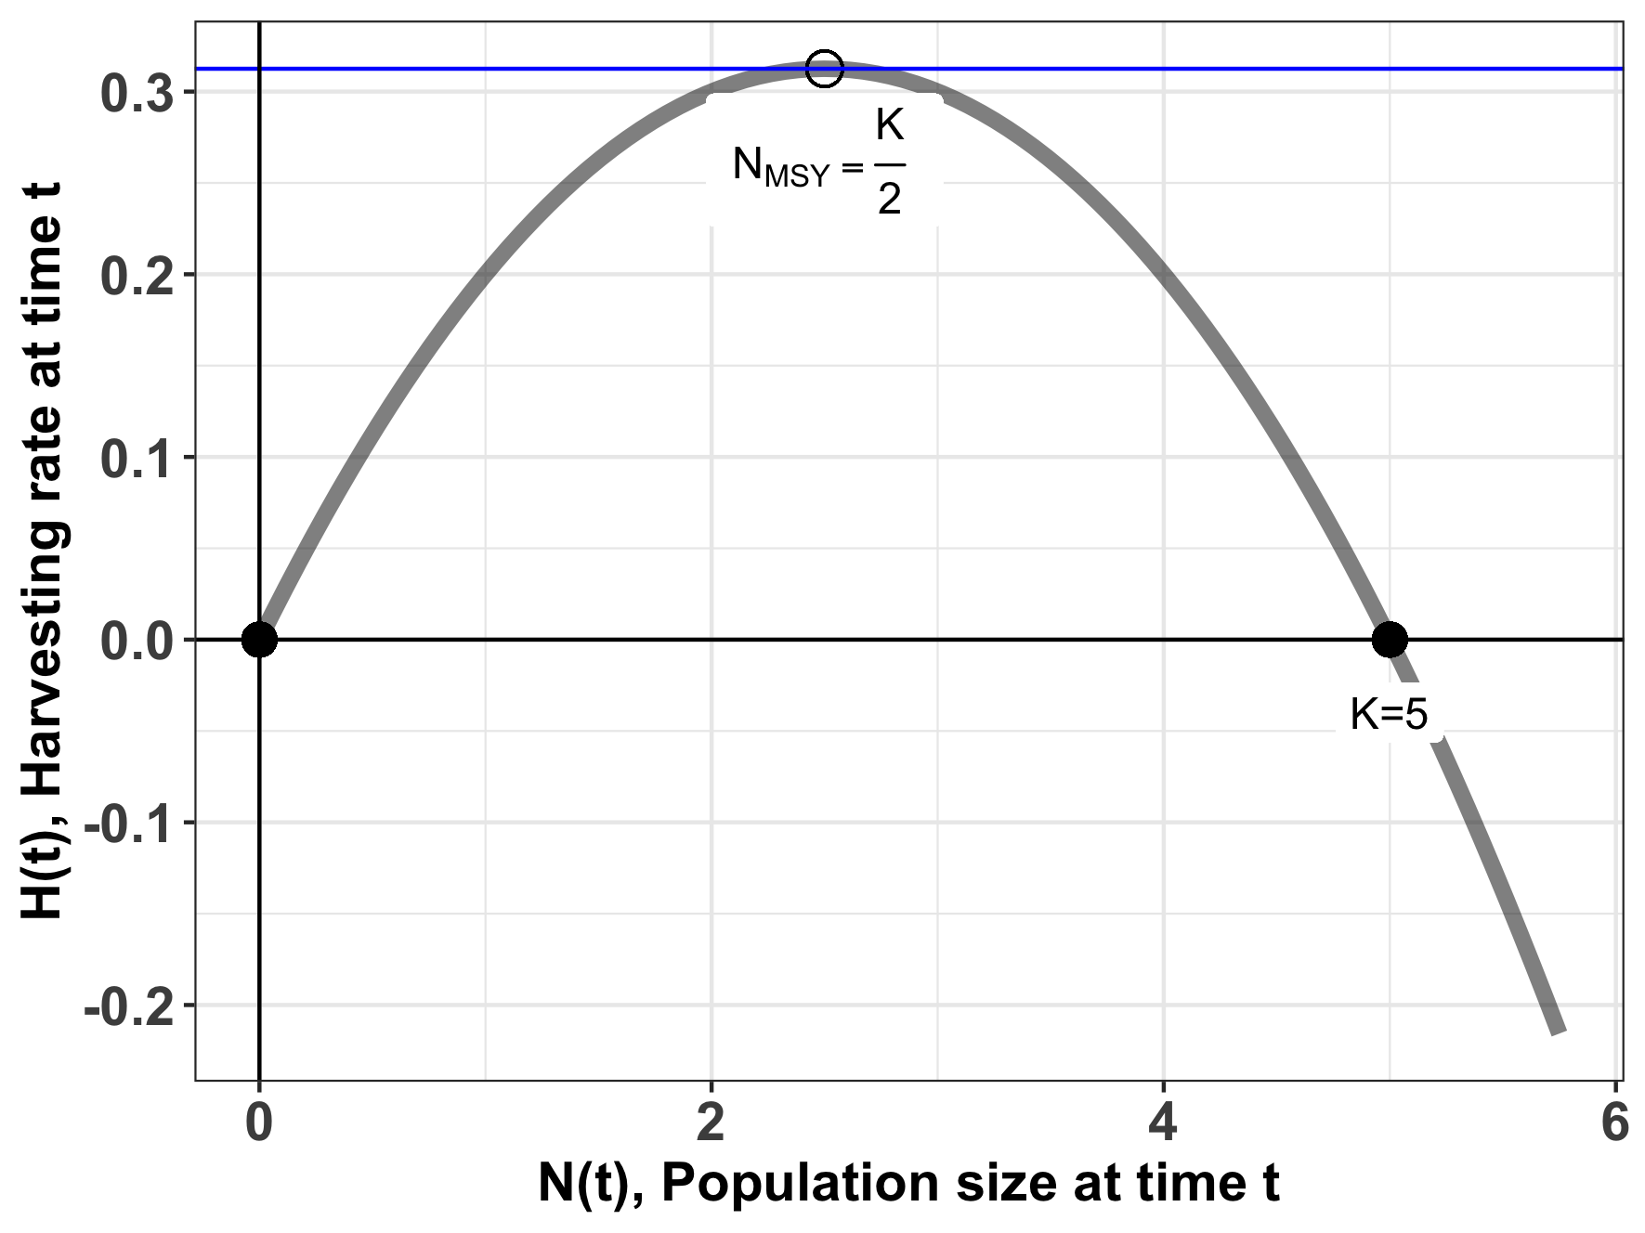
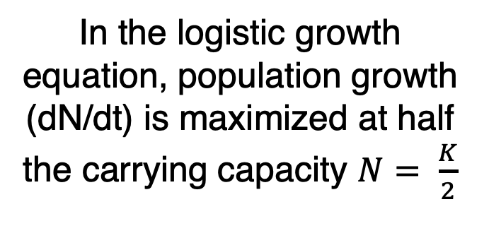
Maximum sustainable yield (MSY)
$$H=rN\left(1−\frac{N}{K}\right)$$
In the logistic growth equation, population growth (dN/dt) is maximized at half the carrying capacity $N= \frac{K}{2}$
Notes:
You can test this by filling in values of N on either side of N=2.5 (try N=3 and N=2) for harvesting = 0.25*5/4 = 0.312

Slide 22
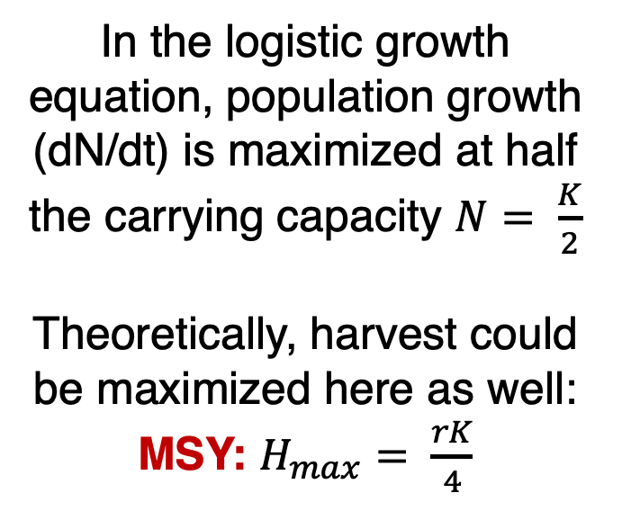
Maximum sustainable yield (MSY)
$$H=rN\left(1−\frac{N}{K}\right)$$
In the logistic growth equation, population growth (dN/dt) is maximized at half the carrying capacity $N= \frac{K}{2}$
Theoretically, harvest could be maximized here as well:
MSY: $H_{max}= \frac{rK}{4}$
take the derivative with respect to N

Slide 23

Maximum sustainable yield (MSY)
$$H=rN\left(1−\frac{N}{K}\right)$$
MSY: $H_{max}= \frac{rK}{4}$
The MSY is a semi-stable equilibrium, meaning that small gains in population size (N) will be compensated to return the system to N_{MSY,} while small losses will result in the system collapsing to N=0.

Slide 24
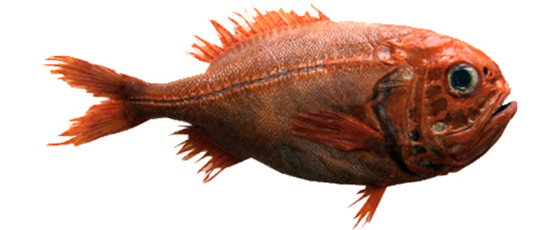
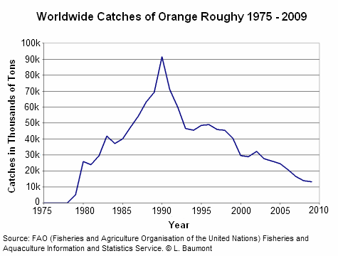
Case Study: Orange Roughy
Found in deep waters of eastern Pacific (Chile), western Pacific (Australia/NZ), and southeastern Atlantic (Namibia to South Africa)
Can live up to 200 years! Matures at 20-30 yrs
Fished via trawling, originally thought to have only a 30-year lifespan
Annual global catches began in 1979 and increased to over 90,000 tons in the late 1980s.
High catch levels quickly decreased as stocks were fished down. By the late 1990s, three of the eight NZ orange roughy fisheries had collapsed and were closed.

Slide 25
Case Study: Orange Roughy
Found in deep waters of eastern Pacific (Chile), western Pacific (Australia/NZ), and southeastern Atlantic (Namibia to South Africa)
Can live up to 200 years! Matures at 20-30 yrs
Fished via trawling, originally thought to have only a 30-year lifespan
Annual global catches began in 1979 and increased to over 90,000 tons in the late 1980s.
High catch levels quickly decreased as stocks were fished down. By the late 1990s, three of the eight NZ orange roughy fisheries had collapsed and were closed.

Slide 26
Case Study: Orange Roughy
Found in deep waters of eastern Pacific (Chile), western Pacific (Australia/NZ), and southeastern Atlantic (Namibia to South Africa)
Can live up to 200 years! Matures at 20-30 yrs
Fished via trawling, originally thought to have only a 30-year lifespan
Annual global catches began in 1979 and increased to over 90,000 tons in the late 1980s.
High catch levels quickly decreased as stocks were fished down. By the late 1990s, three of the eight NZ orange roughy fisheries had collapsed and were closed.

Slide 27
Case Study: Orange Roughy
Found in deep waters of eastern Pacific (Chile), western Pacific (Australia/NZ), and southeastern Atlantic (Namibia to South Africa)
Can live up to 200 years! Matures at 20-30 yrs
Fished via trawling, originally thought to have only a 30-year lifespan
Annual global catches began in 1979 and increased to over 90,000 tons in the late 1980s.
High catch levels quickly decreased as stocks were fished down. By the late 1990s, three of the eight NZ orange roughy fisheries had collapsed and were closed.

Slide 28
Case Study: Orange Roughy
Found in deep waters of eastern Pacific (Chile), western Pacific (Australia/NZ), and southeastern Atlantic (Namibia to South Africa)
Can live up to 200 years! Matures at 20-30 yrs
Fished via trawling, originally thought to have only a 30-year lifespan
Annual global catches began in 1979 and increased to over 90,000 tons in the late 1980s.
High catch levels quickly decreased as stocks were fished down. By the late 1990s, three of the eight NZ orange roughy fisheries had collapsed and were closed.

Slide 29
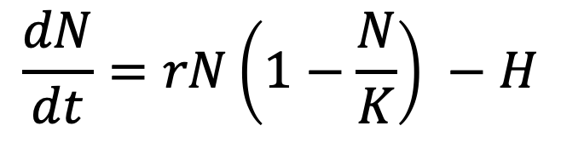
The case of the orange roughy highlights many of the inherent problems with MSY
r and K and N are difficult to measure.
Many harvesting models neglect population structure.
Simple harvesting models assume constant harvest.
MSY fails to acknowledge the reality of overfishing.
Because of the semi-stable equilibrium at MSY, small (natural) decreases in N can be devastating
environmental stochasticity
demographic stochasticity
$$\frac{dN}{dt}=rN\left(1−\frac{N}{K}\right) −H$$

Slide 30
The case of the orange roughy highlights many of the inherent problems with MSY
r and K and N are difficult to measure.
Many harvesting models neglect population structure or model only a single species in isolation.
or model only a single species in isolation.
Simple harvesting models assume constant harvest.
MSY fails to acknowledge the reality of overfishing.
Because of the semi-stable equilibrium at MSY, small (natural) decreases in N can be devastating
environmental stochasticity
demographic stochasticity
$$\frac{dN}{dt}=rN\left(1−\frac{N}{K}\right) −H$$

Slide 31
The case of the orange roughy highlights many of the inherent problems with MSY
r and K and N are difficult to measure.
Many harvesting models neglect population structure or model only a single species in isolation.
Simple harvesting models assume constant harvest.
MSY fails to acknowledge the reality of overfishing.
Because of the semi-stable equilibrium at MSY, small (natural) decreases in N can be devastating
environmental stochasticity
demographic stochasticity
$$\frac{dN}{dt}=rN\left(1−\frac{N}{K}\right) −H$$

Slide 32
The case of the orange roughy highlights many of the inherent problems with MSY
r and K and N are difficult to measure.
Many harvesting models neglect population structure or model only a single species in isolation.
Simple harvesting models assume constant harvest.
MSY fails to acknowledge the reality of overfishing.
Because of the semi-stable equilibrium at MSY, small (natural) decreases in N can be devastating
environmental stochasticity
demographic stochasticity
$$\frac{dN}{dt}=rN\left(1−\frac{N}{K}\right) −H$$

Slide 33
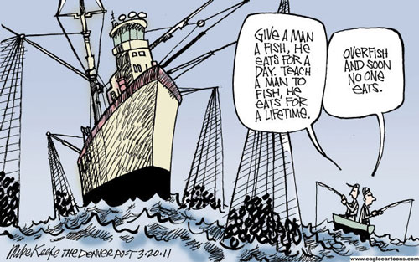
Overfishing: A Tragedy of the Commons
Tragedy of the Commons: A situation in which individual users, who have open access to a common pool resource, cause depletion of the resource through their uncoordinated actions.
Idea was popularized by ecologist Garret Hardin in 1968, a Malthus-like reference to the overpopulation of the Earth
Fisheries provide a classic example of Tragedy of the Commons because property rights are incomplete and access is open.
Many examples of fisheries collapse:
Sturgeon in Caspian sea in 2000s
Atlantic cod in Canada & elsewhere in 1990s
Orange roughy in NZ in 1990s
Despite its dangers, MSY is still highlight as a policy in many international treaties.
Notes:
Garret Hardin = Malthusian, anti-welfare philosophy
Contrast with Elinor Ostrom’s work on successful cooperation for managing land

Slide 34
Overfishing: A Tragedy of the Commons
Tragedy of the Commons: A situation in which individual users, who have open access to a common pool resource, cause depletion of the resource through their uncoordinated actions.
Idea was popularized by ecologist Garret Hardin in 1968, a Malthus-like reference to the overpopulation of the Earth
Fisheries provide a classic example of Tragedy of the Commons because property rights are incomplete and access is open.
Many examples of fisheries collapse:
Sturgeon in Caspian sea in 2000s
Atlantic cod in Canada & elsewhere in 1990s
Orange roughy in NZ in 1990s
Despite its dangers, MSY is still highlight as a policy in many international treaties.
Notes:
Garret Hardin = Malthusian, anti-welfare philosophy
Contrast with Elinor Ostrom’s work on successful cooperation for managing land

Slide 35
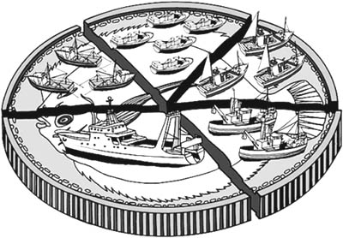
Overfishing: A Tragedy of the Commons
International management of fisheries has been attempted through government coordination to set a Total Allowable Catch (TAC) for each fishery each year.
This practice can lead to intense pressure to fish all at once at the season’s opening, sometimes overshooting the TAC.
This challenge can be mitigated by the use of Individual Fishing Quotas (IFQs) or Individual Transferrable Quotas (ITQs), but allocation is still an issue.
The work of Elinor Ostrom showed that some of these challenges can be overcome when the limits of a resource are clearly defined, when the group of stakeholders is small, and when communication is high.
Notes:
These port-level networks vary in properties such as network resilience (colour of port-location dots: red is lower resilience, green is greater resilience), and they are also comprised of both state and federally managed fisheries (small networks on right: red and blue nodes, respectively).

Slide 36
Overfishing: A Tragedy of the Commons
International management of fisheries has been attempted through government coordination to set a Total Allowable Catch (TAC) for each fishery each year.
This practice can lead to intense pressure to fish all at once at the season’s opening, sometimes overshooting the TAC.
This challenge can be mitigated by the use of Individual Fishing Quotas (IFQs) or Individual Transferrable Quotas (ITQs), but allocation is still an issue.
The work of Elinor Ostrom showed that some of these challenges can be overcome when the limits of a resource are clearly defined, when the group of stakeholders is small, and when communication is high.
Notes:
These port-level networks vary in properties such as network resilience (colour of port-location dots: red is lower resilience, green is greater resilience), and they are also comprised of both state and federally managed fisheries (small networks on right: red and blue nodes, respectively).

Slide 37
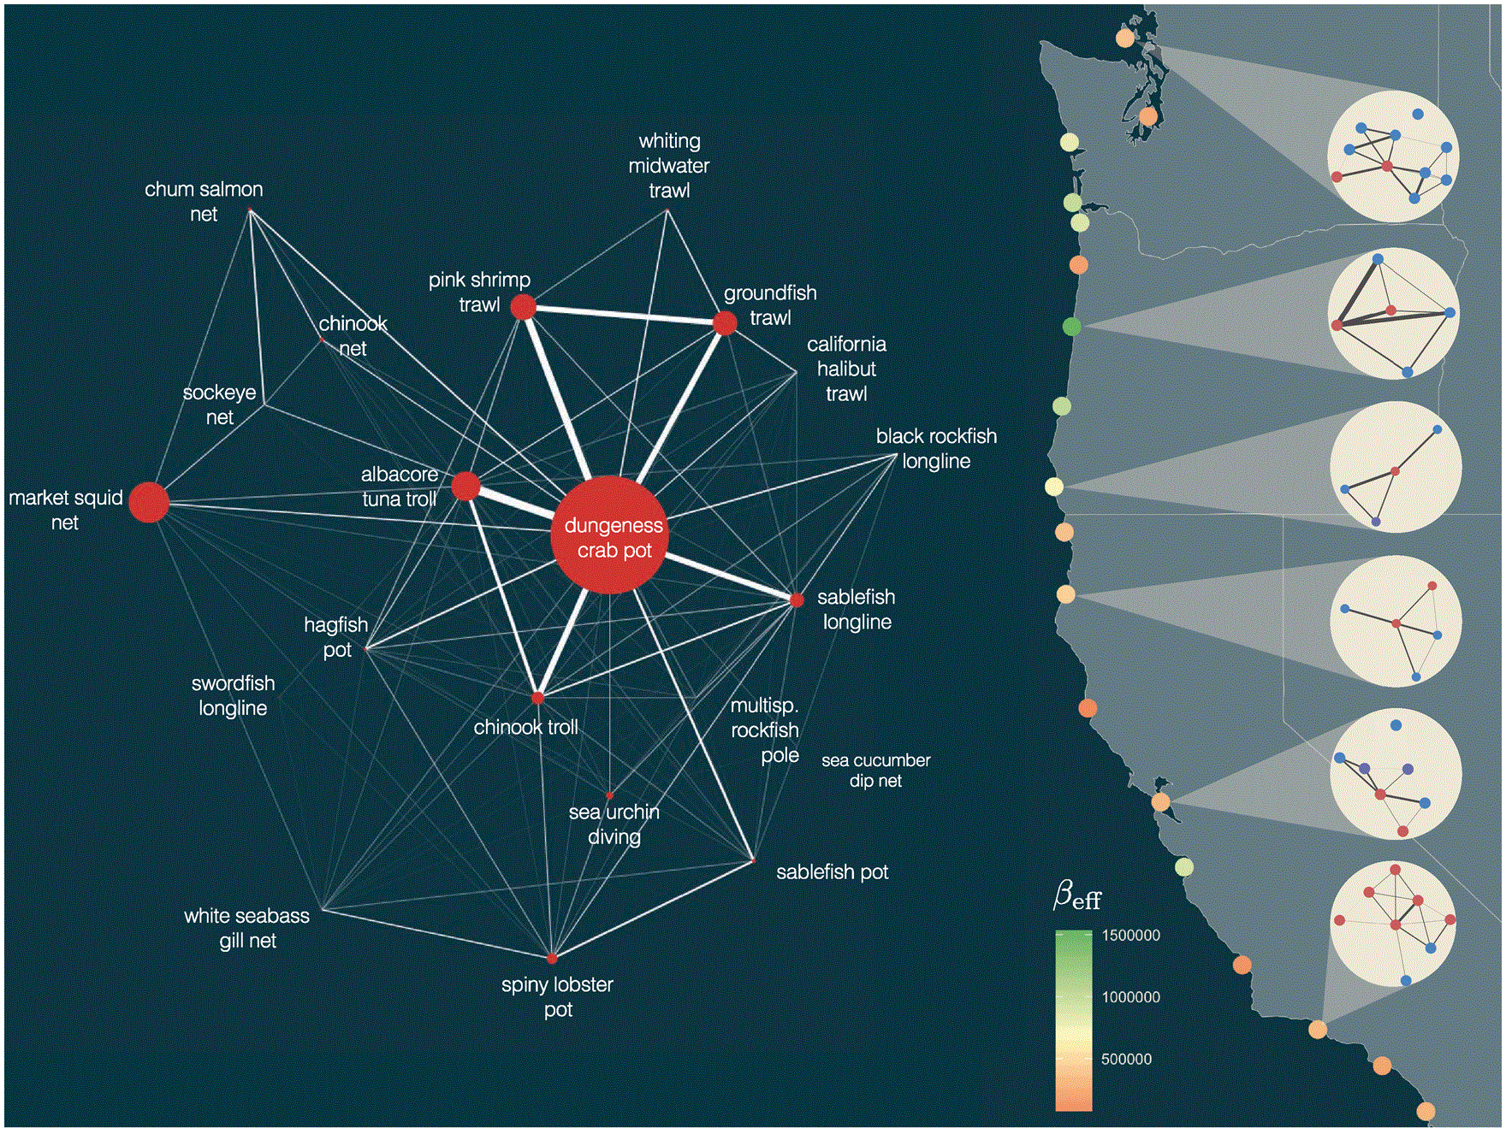
Overfishing: A Tragedy of the Commons
International management of fisheries has been attempted through government coordination to set a Total Allowable Catch (TAC) for each fishery each year.
This practice can lead to intense pressure to fish all at once at the season’s opening, sometimes overshooting the TAC.
This challenge can be mitigated by the use of Individual Fishing Quotas (IFQs) or Individual Transferrable Quotas (ITQs), but allocation is still an issue.
The work of Elinor Ostrom showed that some of these challenges can be overcome when the limits of a resource are clearly defined, when the group of stakeholders is small, and when communication is high.
Dr. Emma Fuller, Fractal Agriculture
Fuller et al. 2017. ICES Journal of Marine Science
Notes:
These port-level networks vary in properties such as network resilience (colour of port-location dots: red is lower resilience, green is greater resilience), and they are also comprised of both state and federally managed fisheries (small networks on right: red and blue nodes, respectively).

Slide 38
The case of the orange roughy highlights many of the inherent problems with MSY
r and K and N are difficult to measure.
Many harvesting models neglect population structure or model only a single species in isolation.
Simple harvesting models assume constant harvest.
MSY fails to acknowledge the reality of overfishing.
Because of the semi-stable equilibrium at MSY, small (natural) decreases in N can be devastating
environmental stochasticity
demographic stochasticity
$$\frac{dN}{dt}=rN\left(1−\frac{N}{K}\right) −H$$

Slide 39
Deterministic vs. Stochastic

Slide 40

Deterministic vs. Stochastic
if deterministic
“always the same”
annual survival rate = 0.5

Slide 41
Deterministic vs. Stochastic
if deterministic
“always the same”
annual survival rate = 0.5

Slide 42
Deterministic vs. Stochastic
if deterministic
“always the same”
annual survival rate = 0.5
All the models we have looked at so far have been deterministic!

Slide 43
Deterministic vs. Stochastic
if deterministic
“always the same”
annual survival rate = 0.5
if stochastic
“up to chance”
annual survival rate = 0.5

Slide 44
Deterministic vs. Stochastic
if deterministic
“always the same”
annual survival rate = 0.5
if stochastic
“up to chance”
annual survival rate = 0.5

Slide 45
Deterministic vs. Stochastic
if deterministic
“always the same”
annual survival rate = 0.5
if stochastic
“up to chance”
annual survival rate = 0.5

Slide 46
The case of the orange roughy highlights many of the inherent problems with MSY
r and K and N = difficult to measure.
Neglect population structure.
Single species models.
Assumes constant harvest.
Ignores reality of overfishing.
Because of the semi-stable equilibrium at MSY, small (natural) decreases in N can be devastating
environmental stochasticity
temporal changes in mortality or reproductive rate (e.g. due to climate)
if stochastic
“up to chance”
annual survival rate = 0.5
cyclone year!
Notes:
Demographic stochasticity describes the within-individual variability (growth rate might vary from one individual to the next)
while environmental stochasticity refers to temporary environmental fluctuations that lead to changes in population growth rates (climate change and egg survival)

Slide 47
The case of the orange roughy highlights many of the inherent problems with MSY
r and K and N = difficult to measure.
Neglect population structure.
Single species models.
Assumes constant harvest.
Ignores reality of overfishing.
Because of the semi-stable equilibrium at MSY, small (natural) decreases in N can be devastating
environmental stochasticity
temporal changes in mortality or reproductive rate (due to climate)
demographic stochasticity
individual-level differences in mortality and reproduction, esp. at small pop size
if deterministic
“always the same”
annual fecundity = 0.5
Notes:
Demographic stochasticity describes the within-individual variability (growth rate might vary from one individual to the next)
while environmental stochasticity refers to temporary environmental fluctuations that lead to changes in population growth rates (climate change and egg survival)

Slide 48


The case of the orange roughy highlights many of the inherent problems with MSY
r and K and N = difficult to measure.
Neglect population structure.
Single species models.
Assumes constant harvest.
Ignores reality of overfishing.
Because of the semi-stable equilibrium at MSY, small (natural) decreases in N can be devastating
environmental stochasticity
temporal changes in mortality or reproductive rate (due to climate)
demographic stochasticity
individual-level differences in mortality and reproduction, esp. at small pop size
if stochastic
“up to chance”
annual fecundity = 0.5
Only one male encounters only one female, so only 1 new fish is born!
Notes:
Demographic stochasticity describes the within-individual variability (growth rate might vary from one individual to the next)
while environmental stochasticity refers to temporary environmental fluctuations that lead to changes in population growth rates (climate change and egg survival)

Slide 49
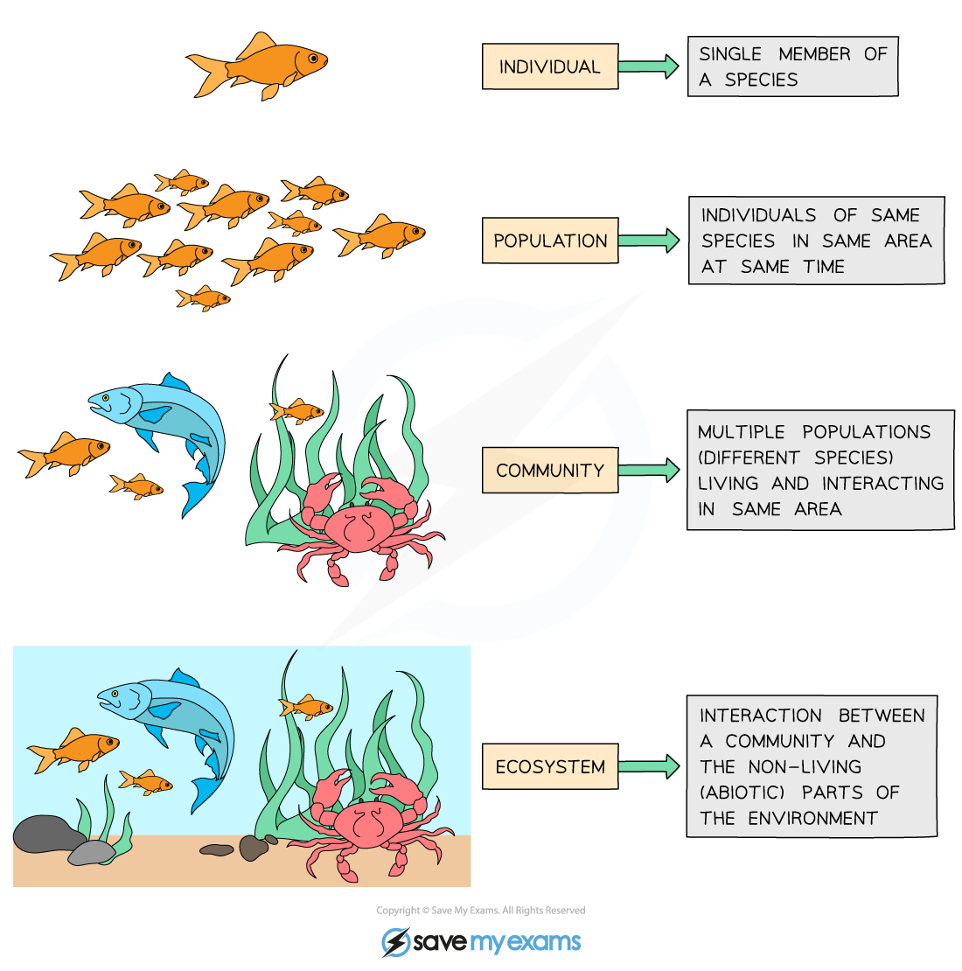
Ecology is the study of the interactions of organisms with each other and their environment.
individual
population
metapopulation
community
ecosystem
Notes:
We explore ecology – using models – across scales

Slide 50
individual
Population = multiple individuals of the same species (conspecifics) in the same habitat
population
metapopulation
fish
(x)
community
How does the abundance of fish change through time?
ecosystem

Slide 51
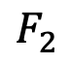
individual
Structured Population = multiple individuals of the same species (conspecifics) in the same habitat but in different life history stages
population
metapopulation
$$F_{2}$$
baby fish (x₁)
adult fish (x₂)
community
1
2
How does the abundance of fish change through time?
ecosystem

Slide 52
Modeling demographic complexity

Slide 53
Modeling demographic complexity
1. Populations are divided into compartments
2. Individuals within a compartment are homogenously mixed
3. Compartments and transition rates are
determined by biological systems
4. Rates of transferring between compartments
are expressed mathematically
births
Madagascar
(N)
deaths
The simplest
population model

Slide 54
Modeling demographic complexity
1. Populations are divided into compartments
2. Individuals within a compartment are homogenously mixed
3. Compartments and transition rates are
determined by biological systems
4. Rates of transferring between compartments
are expressed mathematically
births
Madagascar
(N)
deaths
What is wrong about this model?

Slide 55
Modeling demographic complexity
1. Populations are divided into compartments
2. Individuals within a compartment are homogenously mixed
3. Compartments and transition rates are
determined by biological systems
4. Rates of transferring between compartments
are expressed mathematically
births
Madagascar
(N)
deaths
What is wrong about this model?

Slide 56
Modeling demographic complexity
1. Populations are divided into compartments
2. Individuals within a compartment are homogenously mixed
3. Compartments and transition rates are
determined by biological systems
4. Rates of transferring between compartments
are expressed mathematically
Babies
Adults
The structured
population model

Slide 57
Modeling demographic complexity
1. Populations are divided into compartments
2. Individuals within a compartment are homogenously mixed
3. Compartments and transition rates are
determined by biological systems
4. Rates of transferring between compartments
are expressed mathematically
Babies
Adults
The structured
population model

Slide 58
Modeling demographic complexity
1. Populations are divided into compartments
2. Individuals within a compartment are homogenously mixed
3. Compartments and transition rates are
determined by biological systems
4. Rates of transferring between compartments
are expressed mathematically
births
Babies
aging
Adults
deaths
deaths
The structured
population model

Slide 59
The structured
population model
1. Populations are divided into compartments
2. Individuals within a compartment are homogenously mixed
3. Compartments and transition rates are
determined by biological systems
4. Rates of transferring between compartments
are expressed mathematically
Births (B)
Population rate of increase
Babies
aging (a)
Adults
λ=N_{t+1}/N_{t}
deaths (1-s_{b})
deaths (1-s_{a})
N_{t+1} = A* N_{t}
pop size at t
pop size at t + 1
matrix of survival and fecundity rates
vector of
population sizes
s_{b}(1-a)
B
s_{b}a
s_{a}

Slide 60
The structured
population model
1. Populations are divided into compartments
2. Individuals within a compartment are homogenously mixed
3. Compartments and transition rates are
determined by biological systems
4. Rates of transferring between compartments
are expressed mathematically
Births (B)
Population rate of increase
Babies
aging (a)
Adults
λ=N_{t+1}/N_{t}
deaths (1-s_{b})
deaths (1-s_{a})
N_{t+1} = A* N_{t}
pop size at t
pop size at t + 1
matrix of survival and fecundity rates
vector of
population sizes
s_{b}(1-a)
B
s_{b}a
s_{a}
*Discrete time

Slide 61
The structured
population model
1. Populations are divided into compartments
2. Individuals within a compartment are homogenously mixed
3. Compartments and transition rates are
determined by biological systems
4. Rates of transferring between compartments
are expressed mathematically
Births (B)
Babies
aging (a)
Adults
deaths (1-s_{b})
deaths (1-s_{a})
N_{t+1} = A* N_{t}
A
N_{t}
N_{t+1}
s_{b}(1-a)
B
N_{b}
s_{b}(1-a) N_{b} + BN_{a}
x
=
s_{b}a
s_{a}
N_{a}
s_{b} a N_{b} + s_{a}N_{a}

Slide 62
The structured
population model
1. Populations are divided into compartments
2. Individuals within a compartment are homogenously mixed
3. Compartments and transition rates are
determined by biological systems
4. Rates of transferring between compartments
are expressed mathematically
Births (B)
Babies
aging (a)
Adults
deaths (1-s_{b})
deaths (1-s_{a})
N_{t+1} = A* N_{t}
A
N_{t}
N_{t+1}
Population rate of increase
λ=dominant eigenvalue of transition matrix
s_{b}(1-a)
B
N_{b}
s_{b}(1-a) N_{b} + BN_{a}
x
=
s_{b}a
s_{a}
N_{a}
s_{b} a N_{b} + s_{a}N_{a}
Population growth will depend on population structure!
(pop grows @ λ >1 & declines @ λ < 1 )

Slide 63
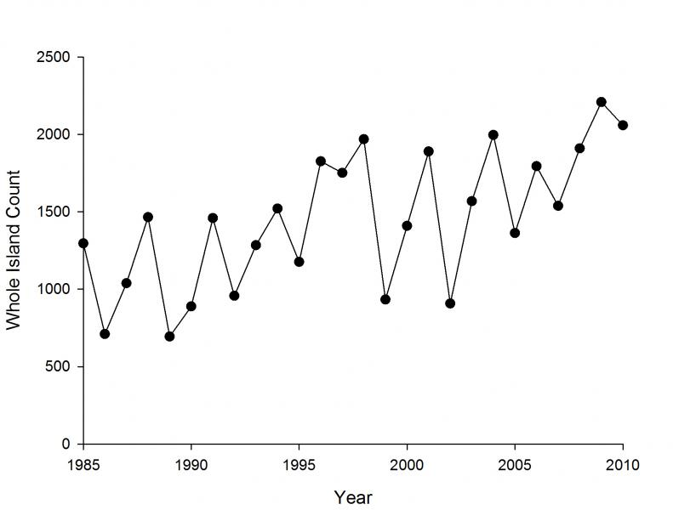
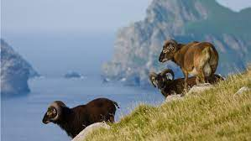
Structured populations in practice
Soay Sheep of St. Kilda, Scotland
Notes:
Since the 1980s, scientists from Cambridge have been censusing them annually and tagging every individual. They exhibit these dramatic population fluctuations

Slide 64
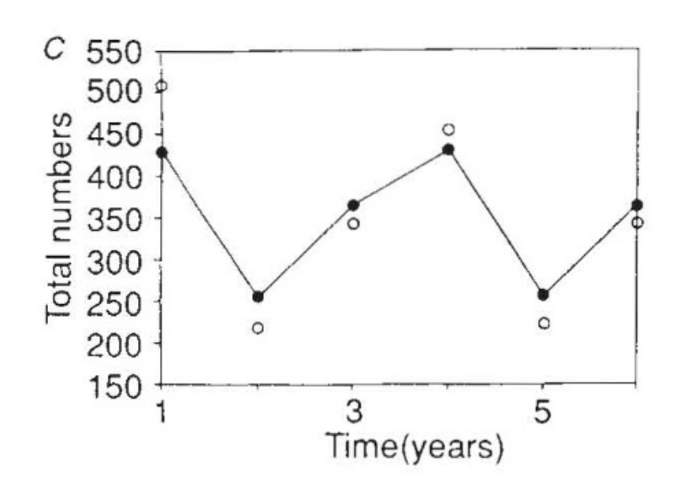
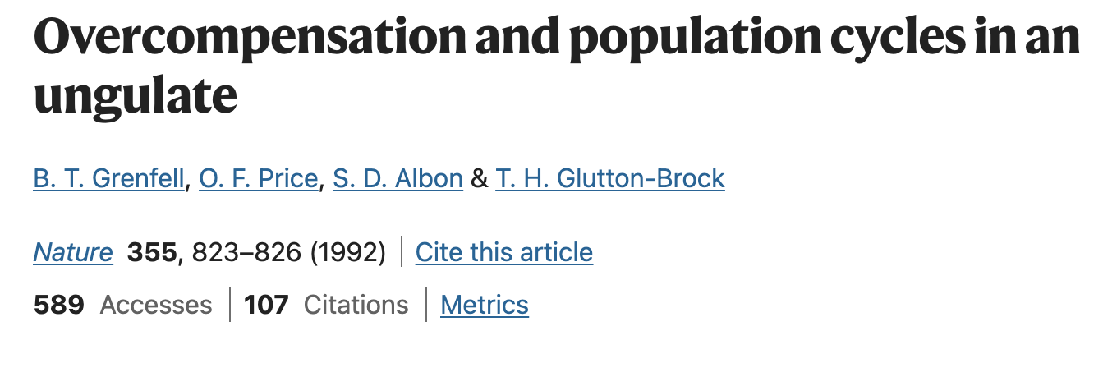
Structured populations in practice
Model compared against data
Soay Sheep of St. Kilda, Scotland
Notes:
Models used both to predict and to explain

Slide 65
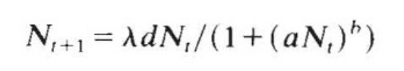
Structured populations in practice
Model compared against data
These results used a simple density-dependent model only!
a and b control the strength of density dependence.
growth rate
population at t+1
average fecundity
population at t
Notes:
Models used both to predict and to explain

Slide 66
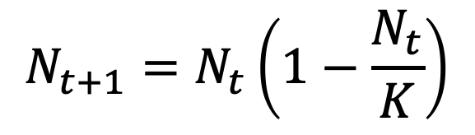
Structured populations in practice
Model compared against data
These results used a simple density-dependent model only!
a and b control the strength of density dependence.
growth rate
population at t+1
average fecundity
population at t
Similar to the simple logistic growth equation!
$$N_{t+1}=N_{t}\left(1−\frac{N_{t}}{K}\right)$$
Notes:
Models used both to predict and to explain

Slide 67
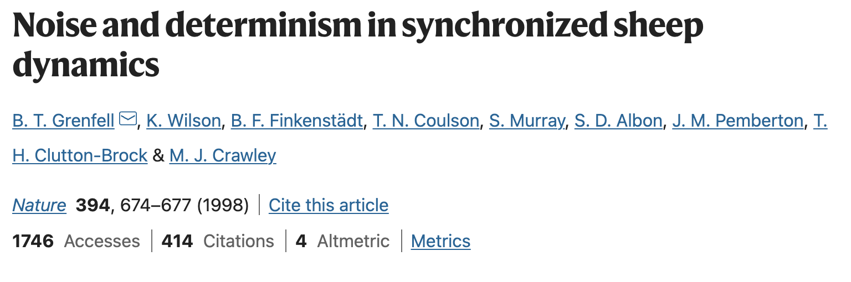
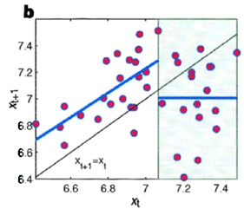
Structured populations in practice
In later work, the authors added environmental stochasticity (bad weather) to better represent the data……
Notes:
Models used both to predict and to explain

Slide 68
Structured populations in practice
In later work, the authors added environmental stochasticity (bad weather) to better represent the data……
Notes:
Models used both to predict and to explain

Slide 69
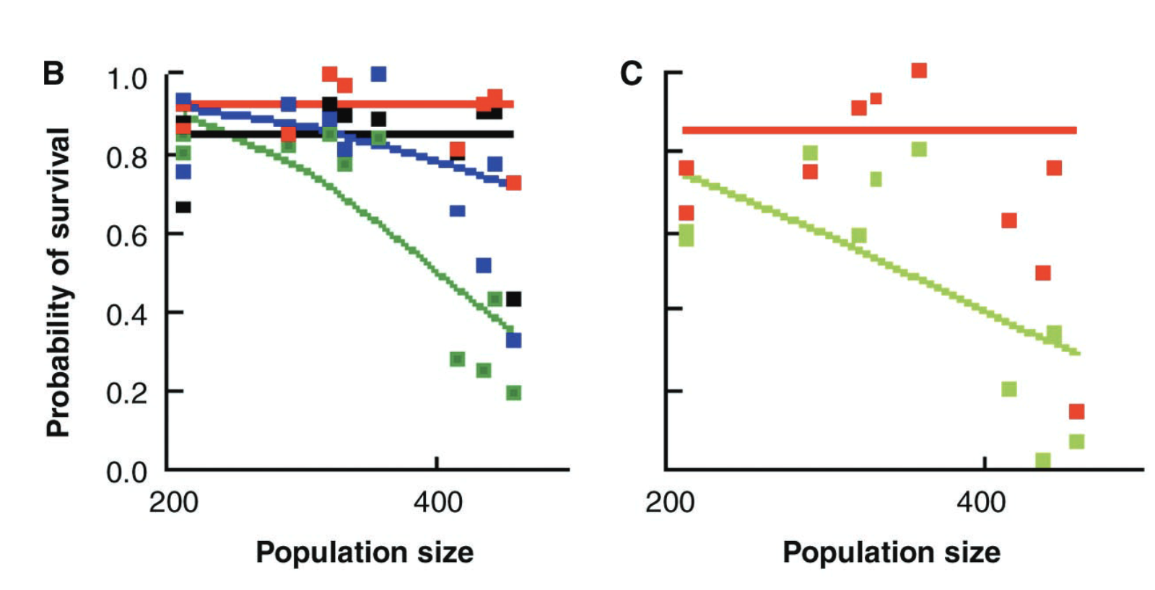
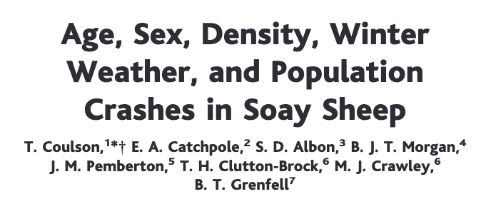

Structured populations in practice
And, finally, they added in population structure as well!
lambs
yearlings
adults
older adults
lambs
adults
Notes:
Colors

Slide 70
The structured
population model
If data are available, we can model much more detailed population structures using the same approach.
F₃
F₄
F₅
F₂
Age₁
Age₂
Age₃
Age₄
Age₅
s₁
s₂
s₃
s₄
The Leslie matrix model divides classes based on age.
The Lefkovitch matrix model divides classes based on life stage.
Leslie 1945 Biometrika. Leslie 1948 Biometrika.
Lefkovitch 1965 Biometrics.

Slide 71
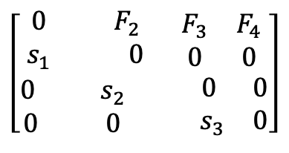
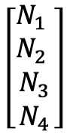
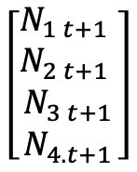
The structured
population model
If data are available, we can model much more detailed population structures using the same approach.
F₃
F₄
F₂
Age₁
Age₂
Age₃
Age₄
s₁
s₂
s₃
A
N_{t}
N_{t+1}
λ=dominant eigenvalue of transition matrix
$$\left[\begin{aligned}\begin{matrix}0 & F_{2} \\ s_{1} & 0\end{matrix} \begin{matrix}F_{3} & F_{4} \\ 0 & 0\end{matrix} \\ \begin{matrix}0 & s_{2} \\ 0 & 0\end{matrix} \begin{matrix} 0 & 0 \\ .{ s}_{3} & 0\end{matrix}\end{aligned}\right]$$
$$\left[\begin{matrix}\begin{matrix}N_{1} \\ N_{2}\end{matrix} \\ \begin{matrix}N_{3} \\ N_{4}\end{matrix}\end{matrix}\right]$$
$$\left[\begin{matrix}\begin{matrix}N_{1 t+1} \\ N_{2 t+1}\end{matrix} \\ \begin{matrix}N_{3 t+1} \\ N_{4.t+1}\end{matrix}\end{matrix}\right]$$
x
=
N_{t+1} = A* N_{t}
Leslie 1945 Biometrika. Leslie 1948 Biometrika.
Lefkovitch 1965 Biometrics.

Slide 72
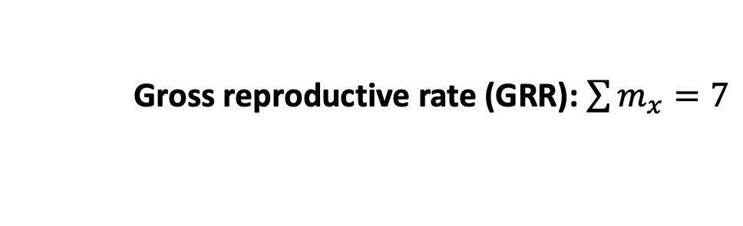
The structured
population model
F₃
F₄
F₂
Age₁
Age₂
Age₃
Age₄
Demographers collect these rates in life tables
s₁
s₂
s₃
x (age) | N_{x} (number in cohort) | l_{x} (survivorship to age x) | m_{x} (fecundity) | l_{x}m_{x}
0 | 100 | 1 | 0 | 0
1 | 60 | .6 | 2 | 1.2
2 | 30 | .3 | 3 | 0.9
3 | 10 | .1 | 1 | 0.1
4 | 1 | .01 | 1 | 0.01
x
=
Gross reproductive rate (GRR): $\sum{m_{x}=7}$

Slide 73
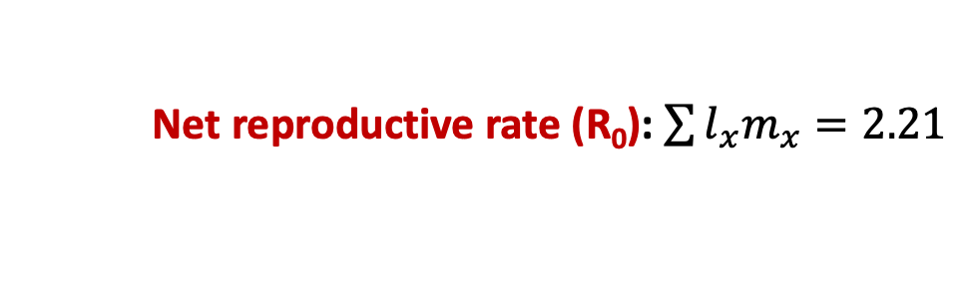
The structured
population model
F₃
F₄
F₂
Age₁
Age₂
Age₃
Age₄
Demographers collect these rates in life tables
s₁
s₂
s₃
x (age) | N_{x} (number in cohort) | l_{x} (survivorship to age x) | m_{x} (fecundity) | l_{x}m_{x}
0 | 100 | 1 | 0 | 0
1 | 60 | .6 | 2 | 1.2
2 | 30 | .3 | 3 | 0.9
3 | 10 | .1 | 1 | 0.1
4 | 1 | .01 | 1 | 0.01
x
=
Net reproductive rate (R₀): $\sum{l_{x}m_{x}=2.21}$

Slide 74
The structured
population model
F₃
F₄
F₂
Age₁
Age₂
Age₃
Age₄
Demographers collect these rates in life tables
s₁
s₂
s₃
x (age) | N_{x} (number in cohort) | l_{x} (survivorship to age x) | m_{x} (fecundity) | l_{x}m_{x}
0 | 100 | 1 | 0 | 0
1 | 60 | .6 | 2 | 1.2
2 | 30 | .3 | 3 | 0.9
3 | 10 | .1 | 1 | 0.1
4 | 1 | .01 | 1 | 0.01
x
=
Net reproductive rate (R₀): $\sum{l_{x}m_{x}=2.21}$
(pop grows at $R0$ >1 and declines at $R0$ < 1)

Slide 75
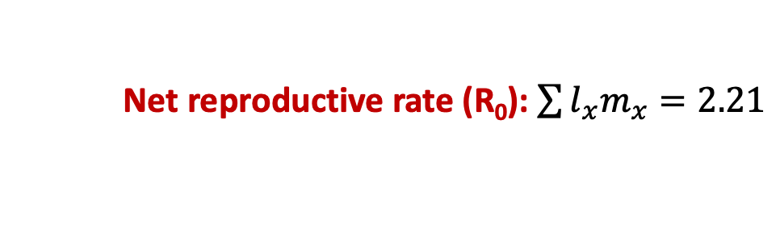
The structured
population model
F₃
F₄
F₂
Age₁
Age₂
Age₃
Age₄
Demographers collect these rates in life tables
s₁
s₂
s₃
x (age) | N_{x} (number in cohort) | l_{x} (survivorship to age x) | m_{x} (fecundity) | l_{x}m_{x}
0 | 100 | 1 | 0 | 0
1 | 60 | .6 | 2 | 1.2
2 | 30 | .3 | 3 | 0.9
3 | 10 | .1 | 1 | 0.1
4 | 1 | .01 | 1 | 0.01
x
=
Net reproductive rate (R₀): $\sum{l_{x}m_{x}=2.21}$
λ = ${R0}^{1/G}$ where G = length of a generation (often 1 year)

Slide 76
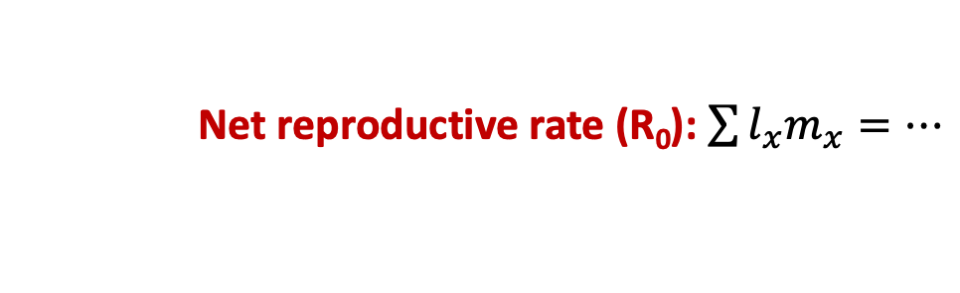
The structured
population model
F₃
F₄
F₂
Age₁
Age₂
Age₃
Age₄
s₁
s₂
s₃
x (age) | N_{x} (number in cohort) | l_{x} (survivorship to age x) | m_{x} (fecundity) | l_{x}m_{x}
0 | 100 | 1 | 0 | 0
1 | 60 | .6 | 2 | 1.2
2 | 30 | .3 | 3 | 0.9
3 | 10 | .1 | 1 | 0.1
4 | 1 | .01 | 1 | 0.01
x
=
…
Orange roughy can live up to 200 years!
Net reproductive rate (R₀): $\sum{l_{x}m_{x}=…}$

Slide 77
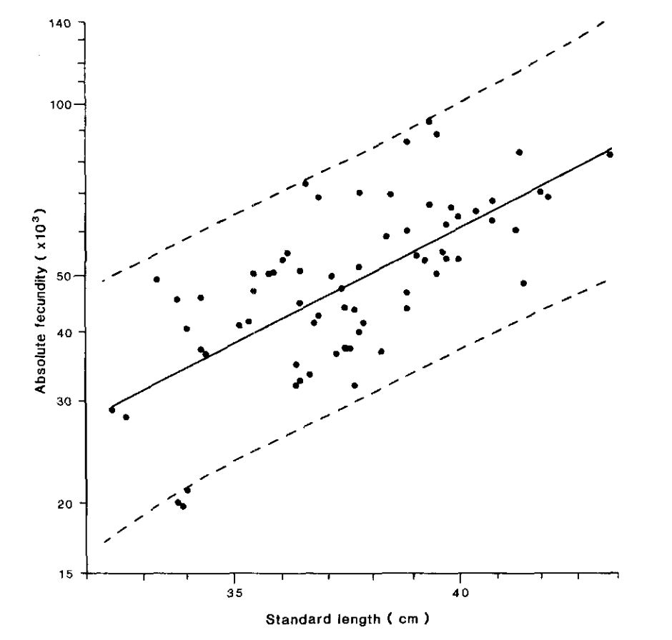

The structured
population model
F₃
F₄
F₂
Age₁
Age₂
Age₃
Age₄
s₁
s₂
s₃
Fecundity (eggs) increases in older, bigger fish!
Absolute fecundity (x10³)
Pankhurst & Conroy 1987
NZ J of Marine & Freshwater Res
Standard length (cm)
Net reproductive rate (R₀): $\sum{l_{x}m_{x}=…}$

Slide 78
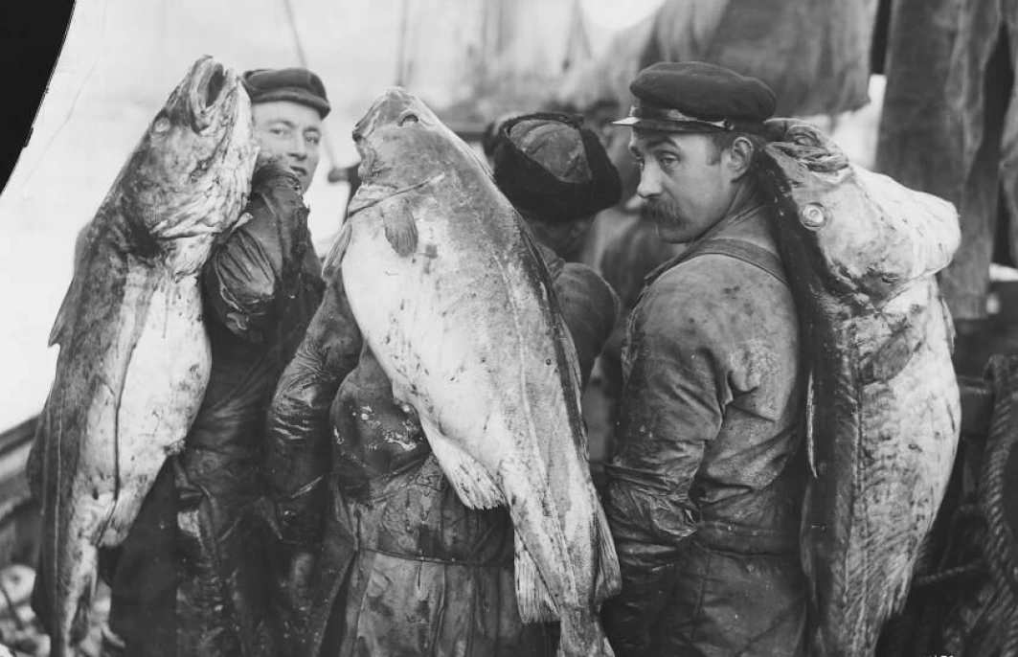
The structured
population model
F₃
F₄
F₂
Age₁
Age₂
Age₃
Age₄
s₁
s₂
s₃
Fecundity (eggs) increases in older, bigger fish!
Absolute fecundity (x10³)
These are precisely the fish we like to catch! One of the problems with MSY…
Norway 1910
(Norsk folkemuseum)
Standard length (cm)

Slide 79
The structured
population model
F₃
F₄
F₂
Age₁
Age₂
Age₃
Age₄
s₁
s₂
s₃
Poor modeling projections has led to severe overexploitation, a common problem in fisheries…
In 2008, the international TAC for orange roughy was reduced from 1470 tons to 914 tons… down from over 90,000 tons in the early 1990s…

Slide 80
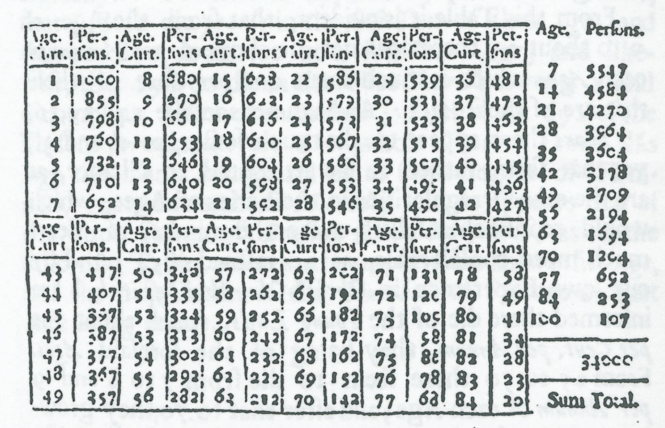
The structured
population model
F₃
F₄
F₂
Age₁
Age₂
Age₃
Age₄
Life table analysis is also used extensively in human demography.
s₁
s₂
s₃
Edmond Halley, 1693
“An estimate of the degrees of the mortality of mankind, drawn from curious tables of the births and funerals at the city of Breslau, with an attempt to ascertain the price of annuities upon lives…”
Notes:
Halley

Slide 81
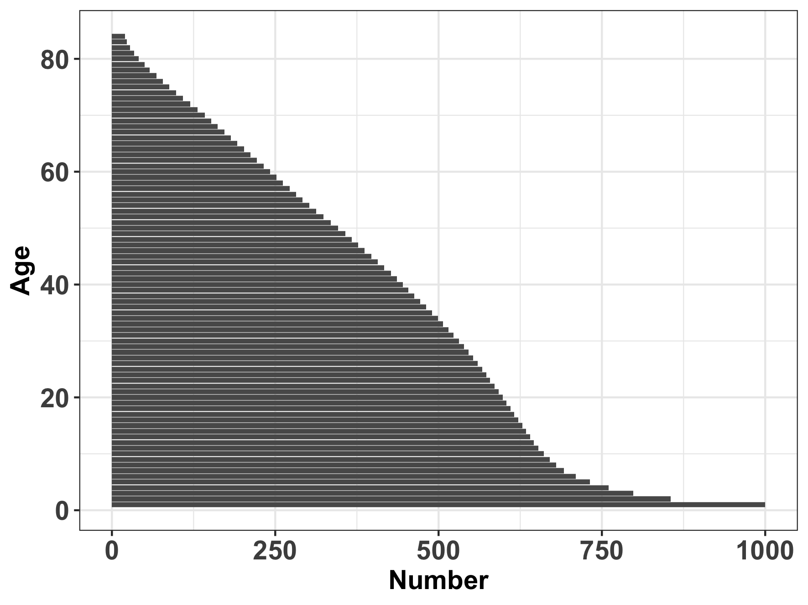
The structured
population model
F₃
F₄
F₂
Age₁
Age₂
Age₃
Age₄
Population pyramid for Breslau
s₁
s₂
s₃
Edmond Halley, 1693
“An estimate of the degrees of the mortality of mankind, drawn from curious tables of the births and funerals at the city of Breslau, with an attempt to ascertain the price of annuities upon lives…”
Notes:
Halley

Slide 82
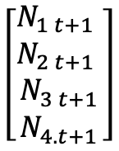
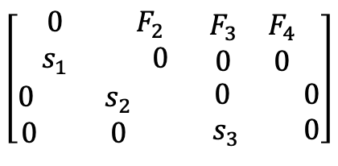
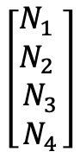
The structured
population model
F₃
F₄
F₂
Age₁
Age₂
Age₃
Age₄
Population pyramid for Breslau
s₁
s₂
s₃
Humans are not like fish!
Fecundity tends to decrease in older age classes due to reproductive senescence.
Younger human populations that start giving birth earlier grow faster!
A
N_{t}
N_{t+1}
$$\left[\begin{aligned}\begin{matrix}0 & F_{2} \\ s_{1} & 0\end{matrix} \begin{matrix}F_{3} & F_{4} \\ 0 & 0\end{matrix} \\ \begin{matrix}0 & s_{2} \\ 0 & 0\end{matrix} \begin{matrix} 0 & 0 \\ .{ s}_{3} & 0\end{matrix}\end{aligned}\right]$$
$$\left[\begin{matrix}\begin{matrix}N_{1} \\ N_{2}\end{matrix} \\ \begin{matrix}N_{3} \\ N_{4}\end{matrix}\end{matrix}\right]$$
$$\left[\begin{matrix}\begin{matrix}N_{1 t+1} \\ N_{2 t+1}\end{matrix} \\ \begin{matrix}N_{3 t+1} \\ N_{4.t+1}\end{matrix}\end{matrix}\right]$$
x
=
Notes:
Halley

Slide 83
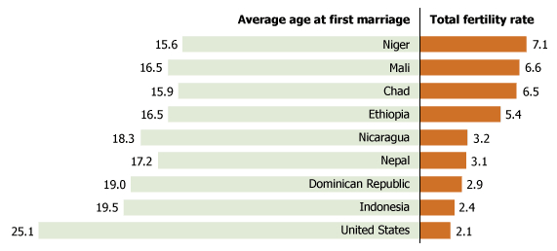

The structured
population model
F₃
F₄
F₂
Age₁
Age₂
Age₃
Age₄
s₁
s₂
s₃
Humans are not like fish!
Fecundity tends to decrease in older age classes due to reproductive senescence.
Younger human populations that start giving birth earlier grow faster!
A
N_{t}
N_{t+1}
$$\left[\begin{aligned}\begin{matrix}0 & F_{2} \\ s_{1} & 0\end{matrix} \begin{matrix}F_{3} & F_{4} \\ 0 & 0\end{matrix} \\ \begin{matrix}0 & s_{2} \\ 0 & 0\end{matrix} \begin{matrix} 0 & 0 \\ .{ s}_{3} & 0\end{matrix}\end{aligned}\right]$$
$$\left[\begin{matrix}\begin{matrix}N_{1} \\ N_{2}\end{matrix} \\ \begin{matrix}N_{3} \\ N_{4}\end{matrix}\end{matrix}\right]$$
$$\left[\begin{matrix}\begin{matrix}N_{1 t+1} \\ N_{2 t+1}\end{matrix} \\ \begin{matrix}N_{3 t+1} \\ N_{4.t+1}\end{matrix}\end{matrix}\right]$$
x
=
Notes:
Total fertility rate = average number of offspring per woman

Slide 84
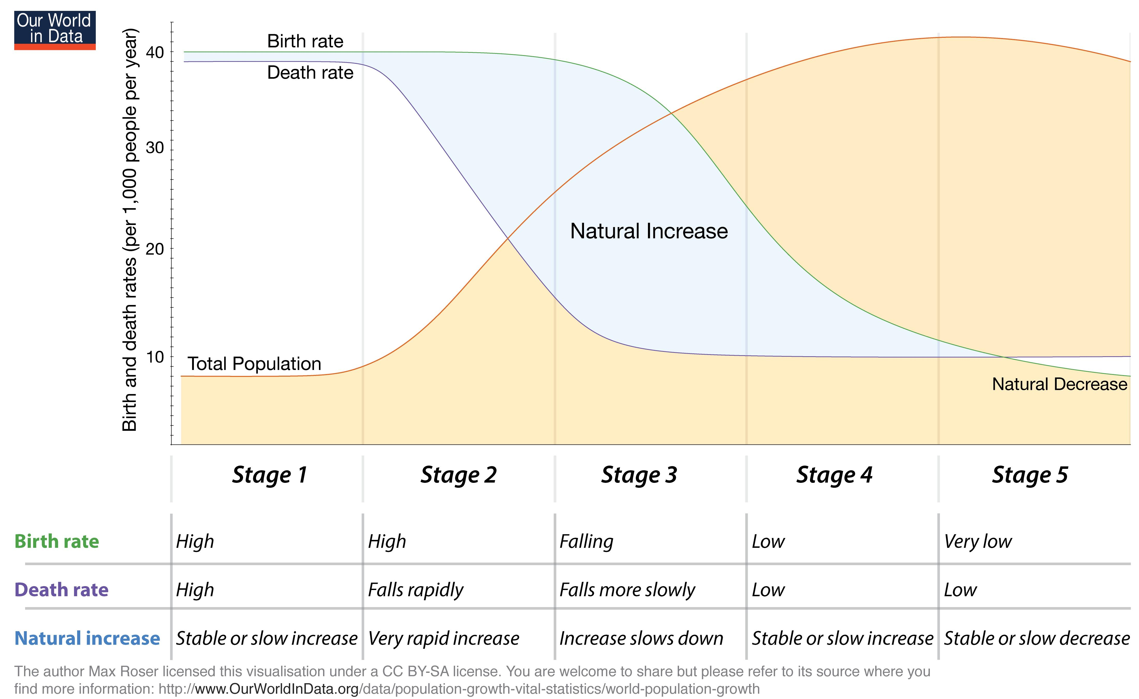
Demographic transition
Notes:
5 stages to a demographic transition – high pop growth in stage 2

Slide 85
Demographic transition
Notes:
5 stages to a demographic transition – high pop growth in stage 2

Slide 86
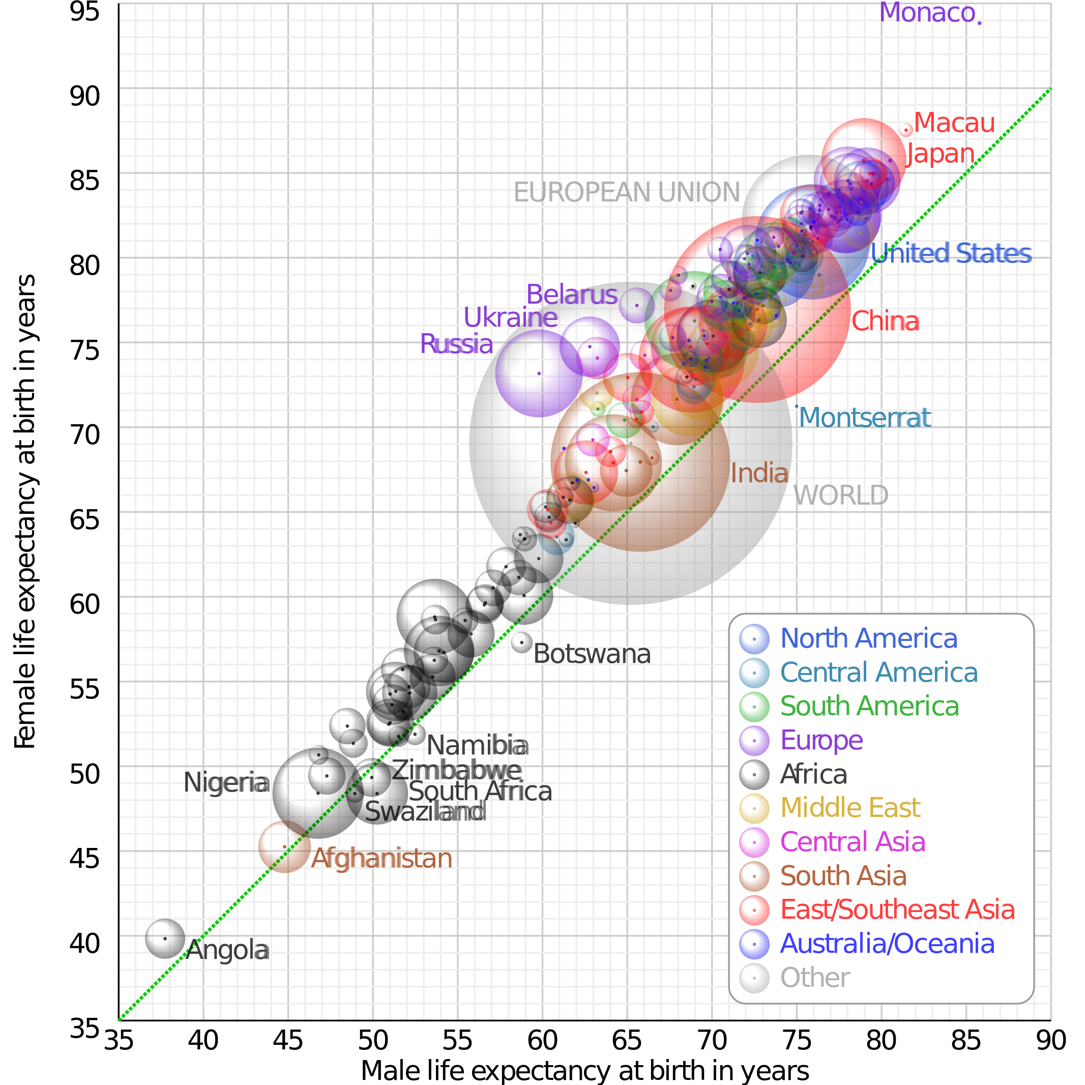
Demographic transition
Death rates are falling globally…

Slide 87
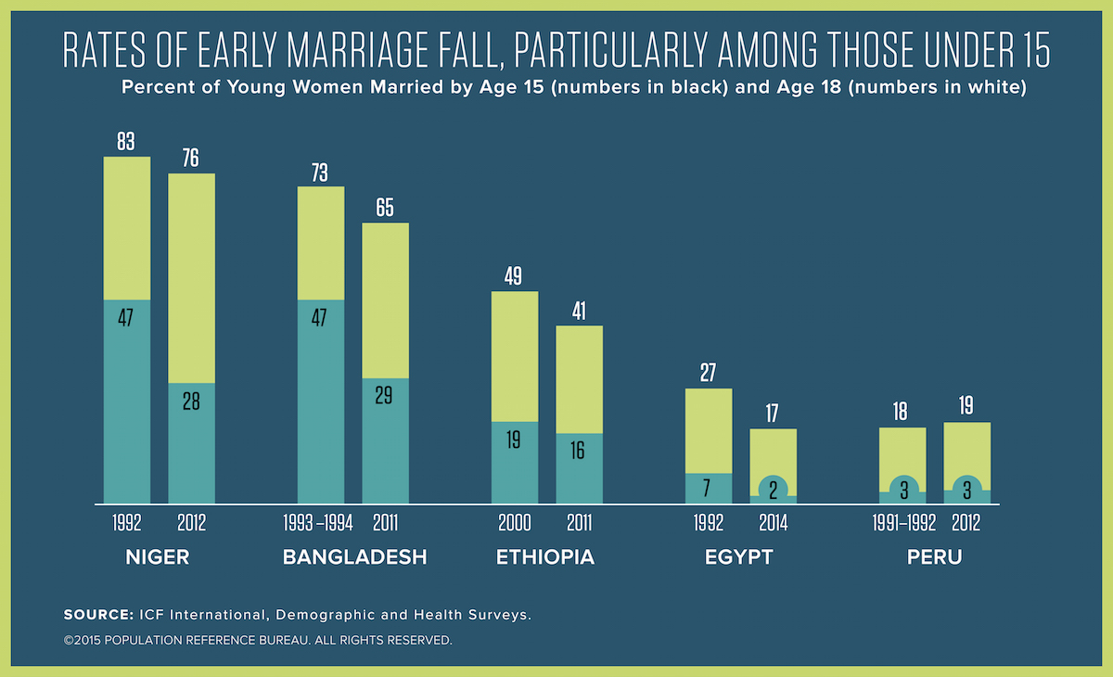
Demographic transition
And birth rates are also falling…

Slide 88
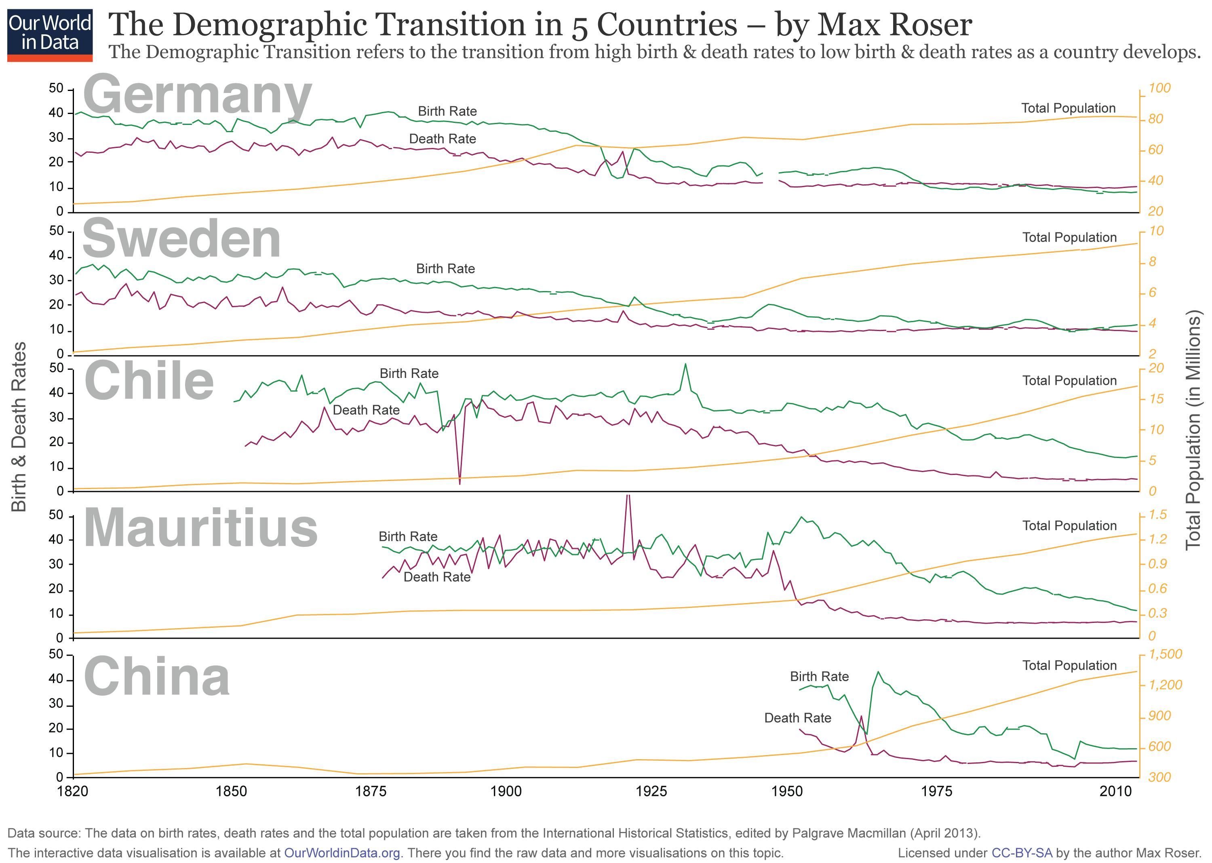
Demographic transition
Notes:
5 stages to a demographic transition – high pop growth in stage 2

Slide 89
Demographic transition
How does age structure predict population growth?
Notes:
5 stages to a demographic transition – high pop growth in stage 2

Slide 90
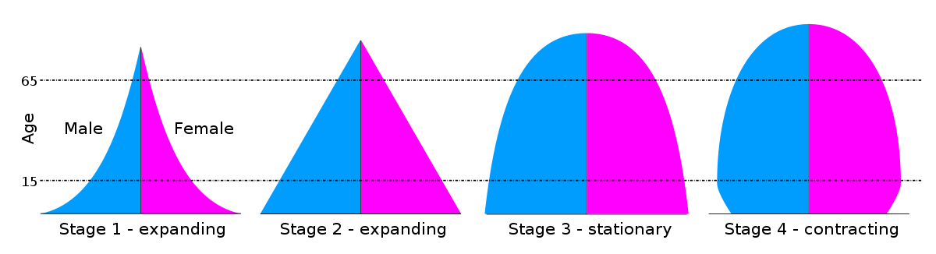
Demographic transition
How does age structure predict population growth?
Notes:
5 stages to a demographic transition – high pop growth in stage 2

Slide 91


Where are we globally?
Notes:
5 stages to a demographic transition – high pop growth in stage 2

Slide 92


Where are we globally?
Notes:
Declining death rates without declining birth rates

Slide 93

Where are we globally?

